Slide 1
Spring 2018
CSC 4760 / 6760 Big Data Programming
Syllabus

Slide 2
Welcome!
Instructor: Yubao Wu
Office: 1 Park Place, Room 662A (6 floor)
Phone: 404-413-6125 (office)
E-mail: ywu28@gsu.edu
Website: iCollege
Office Hours: 3:00 pm - 5:00 pm, Thursday; or by appointment
It is the second time that I teach this course.

Slide 3
Classroom and Date
Classroom: Sparks Hall 311
Date/Time: Monday/Wednesday, 2:50 pm - 4:35 pm
Class type: about 30 undergraduate students + 20 graduate students

Slide 4

TA’s Information
TA: Atul Kaushik
TA’s E-mail: akaushik2@student.gsu.edu
Office: TBD (Probably in the cubicle area of the 6-th floor of 25 Park Place)
Office hours: 3:00 pm - 5:00 pm, Tuesday; or by appointment
Atul has taken CSc 6760 in the Spring 2017 semester.

Slide 5
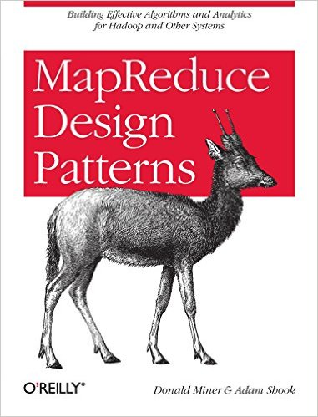
Required Textbook
MapReduce Design Patterns,
by Donald Miner and Adam Shook,
O'Reilly Media, 2012.
ISBN:978-1-449-32717-0
E-book is available.
Repository for example source code:
https://github.com/adamjshook/mapreducepatterns

Slide 6

Required Textbook
Learning Spark: Lightning-Fast Data Analysis,
by Holden Karau, Andy Konwinsky, Patrick Wendell, and Matei Zaharia,
O'Reilly Media, 2015.
ISBN:978-1-449-35862-4
E-book is available.
Example code from Learning Spark book
https://github.com/databricks/learning-spark

Slide 7
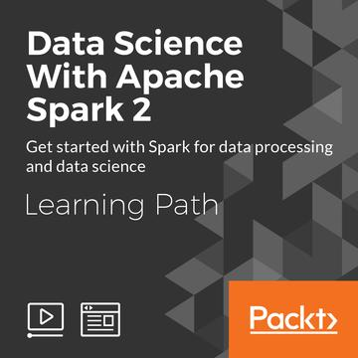
Suggested Textbook
Learning Apache Spark 2,
by Muhammad Asif Abbasi,
2017.

Slide 8


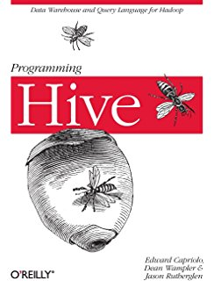
Related books

Slide 9
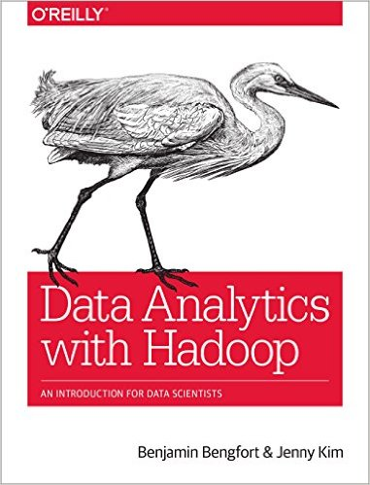
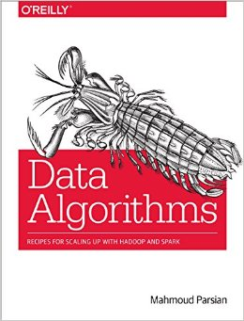
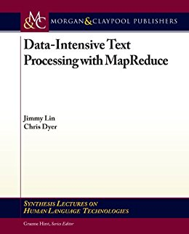
Related books

Slide 10
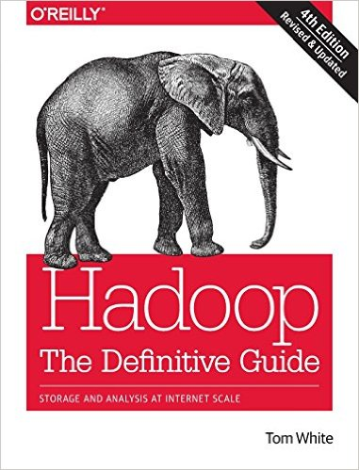
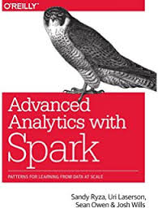
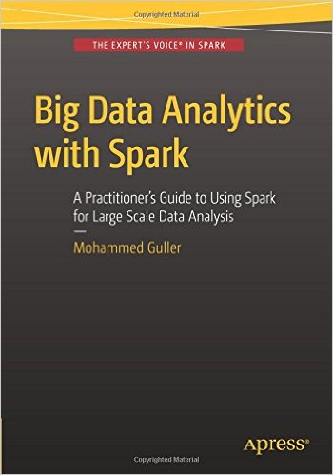
Related books

Slide 11
Related Courses
1. Coursera (https://www.coursera.org)
Data Manipulation at Scale: Systems and Algorithms. Bill Howe. University of Washington.
https://www.coursera.org/learn/data-manipulation/home/welcome
Pig stuff in the above course:
https://www.coursera.org/learn/data-manipulation/lecture/2bKBv/almost-sql-pig
Introduction to Apache Spark and AWS
https://www.coursera.org/learn/bigdata-cluster-apache-spark-and-aws
Big Data Specialization
https://www.coursera.org/specializations/big-data

Slide 12
Related Courses
1. Coursera (https://www.coursera.org) (Continued)
Big Data Analysis with Scala and Spark
https://www.coursera.org/learn/scala-spark-big-data
Big Data Essentials: HDFS, MapReduce and Spark RDD
https://www.coursera.org/learn/big-data-essentials
Big Data Analysis: Hive, Spark SQL, DataFrames, and GraphFrames
https://www.coursera.org/learn/big-data-analysis
Google Cloud Platform Big Data and Machine Learning Fundamentals
https://www.coursera.org/learn/gcp-big-data-ml-fundamentals

Slide 13
Related Courses
2. Cognitive Class (https://cognitiveclass.ai/) (60 online courses in total as of 1/8/2018)
Big Data 101
https://cognitiveclass.ai/courses/what-is-big-data/
Data Science 101
https://cognitiveclass.ai/courses/data-science-101/
MapReduce and YARN
https://cognitiveclass.ai/courses/mapreduce-and-yarn/
Hadoop 101
https://cognitiveclass.ai/courses/introduction-to-hadoop/

Slide 14
Related Courses
2. Cognitive Class (https://cognitiveclass.ai/) (Continued)
Spark Fundamentals I
https://cognitiveclass.ai/courses/what-is-spark/
Spark Fundamentals II
https://cognitiveclass.ai/courses/spark-rdd/
Spark MLlib
https://cognitiveclass.ai/courses/spark-mllib/
Exploring Spark’s GraphX
https://cognitiveclass.ai/courses/spark-graphx/
Apache Pig 101. Warren Pettit, Daniel Tran, Leons Petrazickis. IBM. Big Data University.
https://cognitiveclass.ai/courses/introduction-to-pig/

Slide 15
Related Courses
3. Introduction to MapReduce Programming (A free five-hour crash-course on MapReduce) :
https://archive.bigdatauniversity.com/courses/introduction-to-mapreduce-programming/
4. Intro to Hadoop and MapReduce (by Cloudera) Another (longer) introduction to Hadoop and Map Reduce (FREE):
https://www.udacity.com/course/intro-to-hadoop-and-mapreduce--ud617
5. Hadoop Tutorial: Developing Big-Data Applications with Apache Hadoop
http://www.coreservlets.com/hadoop-tutorial/
This is a great Hadoop tutorial.
6. Big Data Analytics with HDInsight: Hadoop on Azure
https://mva.microsoft.com/en-US/training-courses/big-data-analytics-with-hdinsight-hadoop-on-azure-10551?l=KBcyOu97_7604984382

Slide 16
Related Courses
7. Learning Apache Hadoop EcoSystem- Hive (Free Hive course):
https://www.udemy.com/learning-apache-hive/
8. Free big data tutorials: https://www.dezyre.com/tutorial
9. CS378 - Big Data Programming - Fall 2017 - David Franke. All lecture notes are publicly available.
https://www.cs.utexas.edu/~dfranke/courses/2017fall/cs378-BDP.htm
10. HPCC Systems Online Courses: https://hpccsystems.com/training#Classes . Each student can get a coupon for free access of this online courses.

Slide 17
Online Resources
1. Apache Hadoop: http://hadoop.apache.org/
2. Apache Spark: https://spark.apache.org/
3. Mastering Apache® Spark™ 2.0. http://go.databricks.com/mastering-apache-spark-2.0
4. Cloudera: Machine Learning | Analytics | Cloud: https://www.cloudera.com/
5. BigDL: Distributed Deep Learning on Apache Spark
https://software.intel.com/en-us/articles/bigdl-distributed-deep-learning-on-apache-spark
https://github.com/intel-analytics/BigDL
6. HPCC Systems from LexisNexis: https://hpccsystems.com/

Slide 18
Cloud Service Providers
1. Amazon EMR (Elastic MapReduce): https://aws.amazon.com/emr/
2. Google Cloud Platform: https://cloud.google.com/
3. Microsoft Azure Cloud Computing Platform & Services: https://azure.microsoft.com/en-us/
4. IBM Cloud (BlueMix): https://www.ibm.com/cloud/

Slide 19
Related Research Papers
MapReduce: Simplified Data Processing on Large Clusters, by Jeffry Dean and Sanjay Ghemawat, 2004.
A Comparison of Join Algorithms for Log Processing in MapReduce, by Spyros Blanas, Jignesh M. Patel, Vuk Ercegovac, Jun Rao, Eugene J. Shekita, and Yuanyuan Tian, 2010.
The Family of MapReduce and Large-Scale Data Processing Systems, by Sherif Sakr, Anna Liu, and Ayman G. Fayoumi, 2013.
MapReduce Algorithms for Big Data Analysis, by Kyuseok Shim, 2012.
The Google file system, By Sanjay Ghemawat, et al., 2003.

Slide 20
Related Research Papers
Spark: Cluster Computing with Working Sets. Matei Zaharia, Mosharaf Chowdhury, Michael J. Franklin, Scott Shenker, Ion Stoica. HotCloud 2010. June 2010.
Resilient Distributed Datasets: A Fault-Tolerant Abstraction for In-Memory Cluster Computing. Matei Zaharia, Mosharaf Chowdhury, Tathagata Das, Ankur Dave, Justin Ma, Murphy McCauley, Michael J. Franklin, Scott Shenker, Ion Stoica. NSDI 2012. April 2012. Best Paper Award.
Shark: Fast Data Analysis Using Coarse-grained Distributed Memory (demo). Cliff Engle, Antonio Lupher, Reynold S. Xin, Matei Zaharia, Haoyuan Li, Scott Shenker, Ion Stoica. SIGMOD 2012. May 2012. Best Demo Award.

Slide 21
Related Research Papers
Discretized Streams: An Efficient and Fault-Tolerant Model for Stream Processing on Large Clusters. Matei Zaharia, Tathagata Das, Haoyuan Li, Scott Shenker, Ion Stoica. HotCloud 2012. June 2012.
Discretized Streams: Fault-Tolerant Streaming Computation at Scale. Matei Zaharia, Tathagata Das, Haoyuan Li, Timothy Hunter, Scott Shenker, Ion Stoica. SOSP 2013. November 2013.
Shark: SQL and Rich Analytics at Scale. Reynold S. Xin, Joshua Rosen, Matei Zaharia, Michael J. Franklin, Scott Shenker, Ion Stoica. SIGMOD 2013. June 2013.
GraphX: Unifying Data-Parallel and Graph-Parallel Analytics. Reynold S. Xin, Daniel Crankshaw, Ankur Dave, Joseph E. Gonzalez, Michael J. Franklin, Ion Stoica. OSDI 2014. October 2014.

Slide 22
Related Research Papers
Spark SQL: Relational Data Processing in Spark. Michael Armbrust, Reynold S. Xin, Cheng Lian, Yin Huai, Davies Liu, Joseph K. Bradley, Xiangrui Meng, Tomer Kaftan, Michael J. Franklin, Ali Ghodsi, Matei Zaharia. SIGMOD 2015. June 2015.
SparkR: Scaling R Programs with Spark, Shivaram Venkataraman, Zongheng Yang, Davies Liu, Eric Liang, Hossein Falaki, Xiangrui Meng, Reynold Xin, Ali Ghodsi, Michael Franklin, Ion Stoica, and Matei Zaharia. SIGMOD 2016. June 2016.
MLlib: Machine Learning in Apache Spark, Xiangrui Meng, Joseph Bradley, Burak Yavuz, Evan Sparks, Shivaram Venkataraman, Davies Liu, Jeremy Freeman, DB Tsai, Manish Amde, Sean Owen, Doris Xin, Reynold Xin, Michael J. Franklin, Reza Zadeh, Matei Zaharia, and Ameet Talwalkar. Journal of Machine Learning Research (JMLR). 2016.

Slide 23





Course Contents
Programming in Hadoop (MapReduce) and Spark

Slide 24


Hadoop and Spark Platforms
http://hadoop.apache.org/
http://spark.apache.org/
Several vendors provide Hadoop/Spark distributions
Can download a version that runs on your local machine.
Amazon EMR ­(Elastic MapReduce)
Google Cloud Platform
Microsoft Azure Cloud Computing Platform & Services
IBM Cloud (BlueMix)
Databricks (https://databricks.com/)

Slide 25
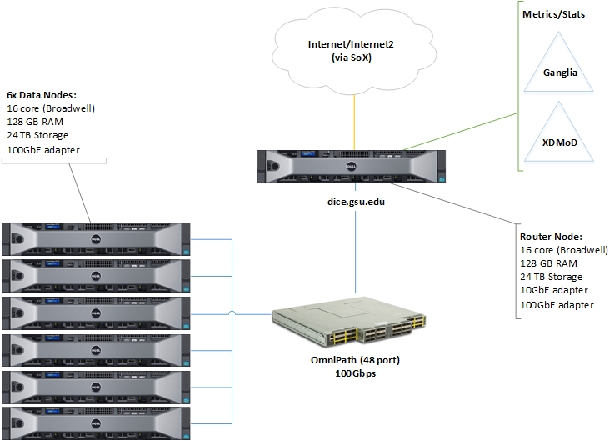
Hadoop/Spark Platform at GSU
Data Intensive Computing Environment (DICE)
https://researchsolutions.atlassian.net/wiki/display/PD/DICE
Request a Dice Account
Get it in 24 hours
Go to https://dice.gsu.edu:8000
Pick Files >> New >> Apache Torri Pyspark notebook

Slide 26
DICE
DICE Specifications are as follows:
CentOS 7.2 64-bit
Hadoop/Spark Ecosystem
1 x Dell PowerEdge 730
16 core (Broadwell), 2x Intel Xeon E5-2620 v4
128 GB RAM
24 TB NLSAS
10 GbE adapter
100 Gbps IB adapter
6 x Dell PowerEdge 730
16 core (Broadwell), 2x Intel Xeon E5-2620 v4
128 GB RAM
24 TB NLSAS
100 Gbps IB adapter

Slide 27
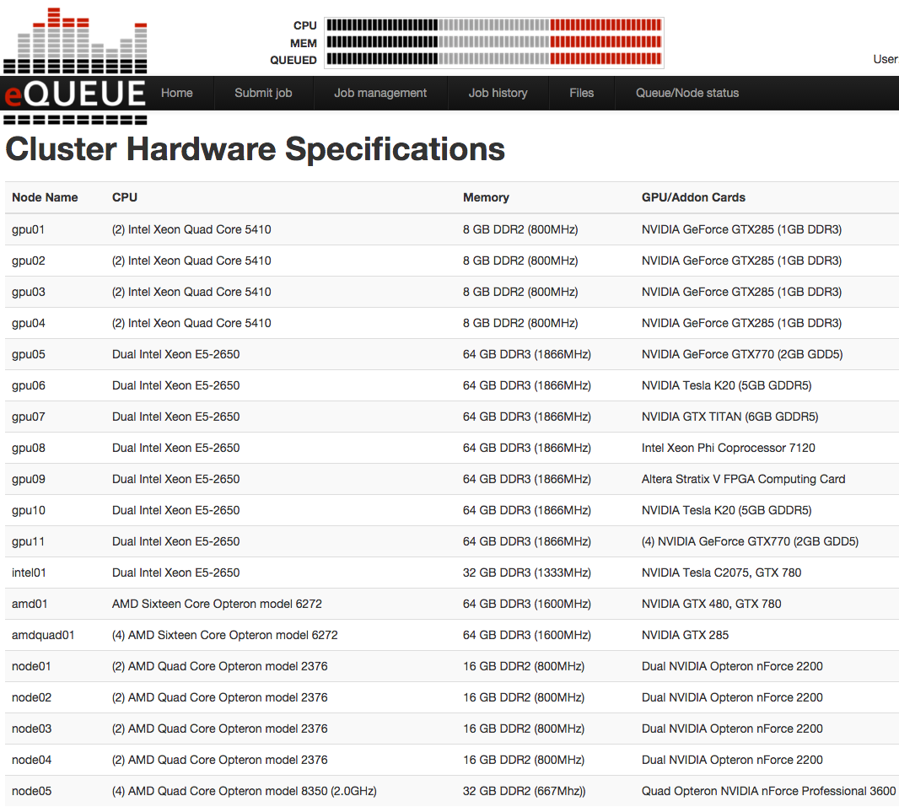

HPC Resources at CS@GSU
DiMos Lab
Distributed & Mobile Systems Lab
Cheetah
http://grid.cs.gsu.edu/~dimos/?q=cheetah_resources
cheetah.gsu.edu
To create an account, send an email to:
CS Helpdesk <cschelp@gsu.edu>

Slide 28
Run Hadoop/Spark on Your Laptop (a Single Node Cluster) – Option 1
Install a Linux virtual machine (like Ubuntu)
Hadoop: Setting up a Single Node Cluster
https://hadoop.apache.org/docs/current/hadoop-project-dist/hadoop-common/SingleCluster.html
Spark Standalone Mode
http://spark.apache.org/docs/latest/spark-standalone.html
It is also possible to run these daemons on a single machine for testing.

Slide 29
Run Hadoop/Spark on Your Laptop (a Single Node Cluster) – Option 2
Install Cloudera (a virtual machine with Linux OS)
Hadoop, Spark, and other tools are already installed and configured in Cloudera
https://www.cloudera.com/downloads/quickstart_vms/5-12.html

Slide 30
Prerequisites
Required Prerequisite: N/A
Suggested Prerequisite:
1) Java and Python Programming
2) Data Structures
3) Analysis of Algorithms
4) Database Systems
5) Machine Learning
6) Data Mining
The department will strictly enforce all prerequisites. Students without proper prerequisites will be dropped from the class, without any prior notice, at any time during the semester.

Slide 31
Recommended books for Java and Python
1) Building Java Programs: A Back to Basics Approach, 4th edition. by Stuart Reges and Marty Stepp. There are slides and other learning materials available online. http://www.buildingjavaprograms.com/
2) Java: A Beginner's Guide, Seventh Edition. By Herbert Schildt. 2017.
3) Introduction to Computing Using Python: An Application Development Focus. Ljubomir Perkovic, 2011.
4) Python Crash Course: A Hands-On, Project-Based Introduction to Programming. By Eric Matthes. 2015.

Slide 32
Suggested online courses for Java and Python
1) Java Tutorial for Complete Beginners. https://www.udemy.com/java-tutorial/
2) Learn Java. https://www.codecademy.com/learn/learn-java
3) Programming Foundations with Python. https://www.udacity.com/course/programming-foundations-with-python--ud036
4) Learn Python. https://www.codecademy.com/learn/learn-python

Slide 33
Course Requirements
Learning Goals:
Assignments, Exams, and Course Project:
Basic theoretical principles
Practical hands-on experience
2 take-home Exams
6 Programming Assignments
Course Project (only for graduate students)

Slide 34
Grading Policy for CSc 4760:
CSC 4760:
Parts | Percentage
Take-home Exam 1 | 15%
Take-home Exam 2 | 15%
Assignment 1 | 8%
Assignment 2 | 12%
Assignment 3 | 12%
Assignment 4 | 8%
Assignment 5 | 12%
Assignment 6 | 12%
Attendance | 6%
Bonus Assignment | 5%
A+ [97, 100] | A [93, 97) | A- [90, 93)
B+ [87, 90) | B [83, 87) | B- [80, 83)
C+ [77, 80) | C [70, 77)
D [60, 70) | F [0, 60)
The total percentage for Assignments is 64%.
The intervals may be adjusted based on the distribution of the scores.
If one student’s score is no less than 97, an A+ will be given.

Slide 35
Grading Policy for CSc 6760:
CSC 6760:
Parts | Percentage
Take-home Exam 1 | 10%
Take-home Exam 2 | 10%
Assignment 1 | 6%
Assignment 2 | 10%
Assignment 3 | 10%
Assignment 4 | 6%
Assignment 5 | 10%
Assignment 6 | 10%
Course Project | 22%
Attendance | 6%
Bonus Assignment | 5%
A+ [97, 100] | A [93, 97) | A- [90, 93)
B+ [87, 90) | B [80, 87)
C+ [77, 80) | C [73, 77) | C- [70, 73)
D [60, 70) | F [0, 60)
The total percentage for Assignments is 52%.
The intervals may be adjusted based on the distribution of the scores.
If one student’s score is no less than 97, an A+ will be given.

Slide 36
Attendance Score for CSC 4760/6760
Grading Policy - Attendance
Absence times | Attendance score
< 3 | 6
3 - 4 | 5
5 - 6 | 4
7 - 8 | 3
9 - 10 | 2
11 - 12 | 1
> 12 | 0
The first two classes (before Jan 12) do not count.

Slide 37
Take-Home Exams
Take-home Exam 1: Open Textbook/Computer
Feb 14-19 (Mid-term)
Mid-point: Feb 27
Take-home Exam 2: Open Textbook/Computer
April 11-16 (Final)
The students should finish the exam individually and separately. The students should not work together.
Plagiarism will result in a score of zero and will be reported to the Dean.
The problems for CSC 4760 and CSC 6760 may be different.

Slide 38
Assignments
6 Assignments
Hands-on programming assignments
Due two weeks after it is given. The scores and solutions will be posted once the TA finishes the grading after 1 week.
The problems for CSC 4760 and CSC 6760 may be different.

Slide 39
Course Project (Only for Graduate Students)
CSC 6760 :
One or Two graduate students form a group
Each group does a project and submits one project report
Each group will give a final presentation. Each graduate student will present his/her part of work

Slide 40
Course Project (Only for Graduate Students)
Using Hadoop or Spark to solve interesting problems in big data analytics
Things to think about when you propose the project
What is the motivation? Why do you want to study this problem?
What is the dataset? How to get the dataset? How large is the dataset?
What are the existing related works? How does this problem have been tackled by the other researchers?
What is the baseline solution method? How can we design sequential algorithms to solve this problem? What is the baseline MapReduce/Hadoop or Spark algorithm for solving this problem? What are the limitations?
What is the novel technical contribution in your method? How significantly does the proposed algorithm improve the computing efficiency?

Slide 41
Course Project (Only for Graduate Students)
Using Hadoop or Spark to solve interesting problems in big data analytics
Some project ideas (only examples, best to propose your own)
Statistical Computing (Speed up traditional statistical methods, such as correlation computation)
Data Mining in Business Applications (Customer Segmentation, Accounting, Marketing)
Literature Survey
Mining Biological Datasets
Social Network Analysis
Your own ideas

Slide 42
Course Project (Only for Graduate Students)
Project proposal ( > 2 pages, ACM SIG template)
Title, project idea, survey of related work, data source, key algorithms/technology, and what you expect to submit at the end of the semester.
Final report ( > 4 pages , ACM SIG template)
A comprehensive description of your project.
project idea, extended survey of related work, detailed algorithm/technology, specific implementation, key results
what worked, what did not work, what surprised you, and why
ACM SIG template (MS Word, or Latex):
https://www.acm.org/publications/proceedings-template-16dec2016

Slide 43
Course Project (Only for Graduate Students)
CSC 6760:
Parts | Percentage
Proposal | 15%
Final Report | 40%
Software/source code, user manual, and sample dataset | 20%
Slides and Presentation | 25%
Project Proposal (> 2 pages)
Final Report (> 4 pages)
Software, user manual, and sample dataset
Slides (> 12 slides)
One or two graduate students form a group to do one project.

Slide 44
Course Project
Final presentation
In the last two or three classes, each group of graduate students present their project to the rest of the class. Each student in one group need to present his/her own part of work in the project.
About 12 - 20 minute presentation including 2-3 minute questions. The time allocated for each group may vary depending on the total number of groups.
Checkpoints
Proposal (due Feb 10): ~ 1 month
Final Report (due April 23): ~ 2 months

Slide 45
Class Policy:
Attendance: Students are required to attend all classes.
Academic honesty: Plagiarism will result in a score of zero on the exams, assignments, or the course project. Plagiarism will be reported to the Dean. The instructor has the right to make a decision.
Assignments and Projects: They are better to be handed in on time. Late submissions will get 20% penalty. Late submissions will not be accepted after 1 week of the due date.
Withdrawals: Feb 27 Tuesday (Midpoint) is the last day to withdraw and possibly receive a W.
Make-ups: need the instructor's special permission.

Slide 46
Tentative Course Outline and Schedule:
Date | Class | Content
Jan. 8 | Class 1 | Syllabus, Introduction to Big Data (Classes Begin)
Jan. 10 | Class 2 | MapReduce Design Patterns, Ch. 1 MapReduce/WordCount
Jan. 12 | -- | End of Student late registration and add/drop
Jan. 15 | No Class | Holiday (MLK)
Jan. 17 | Class 3 | MapReduce Design Patterns, Ch. 2 Summarization Patterns, Min Max Count, Average, Inverted Index
Jan. 22 | Class 4 | MapReduce Design Patterns, Ch. 3 Filtering Patterns, Distributed Grep, Top-K Pattern, Distinct Pattern
Jan. 24 | Class 5 | MapReduce Design Patterns, Ch. 4 Data Organization Patterns, MapReduce Types, Partitioner, Total Order Sorting, Two Mappers, Binning, Shuffling

Slide 47
Tentative Course Outline and Schedule:
Date | Class | Content
Jan. 29 | Class 6 | MapReduce Design Patterns, Ch. 5 Join Patterns, Reduce Side Join, Replicated Join, Composite Join
Jan. 31 | Class 7 | MapReduce Design Patterns, Ch. 6 Metapatterns
Feb. 5 | Class 8 | MapReduce Design Patterns, Ch. 7 Input and Output Patterns
Feb. 7 | Class 9 | Selected Topics: Pig – Part 1
Feb. 10 | -- | Project Proposal Due (11:59 pm eastern time, Feb. 10)
Feb. 12 | Class 10 | Invited Talk: HPCC – Big Data Platform and Use Cases by Flavio Villanustre, VP, Technology, LexisNexis

Slide 48
Tentative Course Outline and Schedule:
Date | Class | Content
Feb. 14 | Class 11 | Selected Topics: Pig – Part 2 (More time may be spent in discussing Pig); Exam 1 (Take-home)
Feb. 19 | Class 12 | Selected Topics: Hive (More time may be spent in discussing Hive) Exam 1 due
Feb. 21 | Class 13 | Selected Topics: HBase (More time may be spent in discussing HBase)
Feb. 26 | Class 14 | Learning Spark, Ch. 1 Introduction to Spark
Feb. 27 | -- | Midpoint (the last day to withdraw)
Feb. 28 | Class 15 | Learning Spark, Ch. 2 Getting Started

Slide 49
Tentative Course Outline and Schedule:
Date | Class | Content
March 5 | Class 16 | Learning Spark, Ch. 3 Programming with RDDs
March 7 | Class 17 | Learning Spark, Ch. 4 Key Value Pairs
March 12 | No Class | Spring Break
March 14 | No Class | Spring Break
March 19 | Class 18 | Learning Spark, Ch. 5 Loading and Saving Data
March 21 | Class 19 | Learning Spark, Ch. 6 Advanced Spark Programming
March 26 | Class 20 | Learning Spark, Ch. 7 Running on a Cluster

Slide 50
Tentative Course Outline and Schedule:
Date | Class | Content
March 28 | Class 21 | Learning Spark, Ch. 8 Tuning and Debugging Spark
April 2 | Class 22 | Selected Topics: Spark Machine Learning Library
April 4 | Class 23 | Selected Topics: Spark GraphX
April 9 | Class 24 | Other Selected Topics
April 11 | Class 25 | Other Selected Topics ; Exam 2 (Take-home)
April 16 | Class 26 | Project Presentations 1 (Two or three classes will be allocated for presentation depending on the total number of groups.) Exam 2 due

Slide 51
Tentative Course Outline and Schedule:
Date | Class | Content
April 18 | Class 27 | Project Presentations 2
April 23 | Class 28 | Project Presentations 3 (Classes End)
April 23 | -- | Course Project Due (11:59 pm eastern time, April 23)
April 24 – May 1 | -- | Final Exams Period. Final Exam schedule: http://registrar.gsu.edu/registration/semester-calendars-exam-schedules/spring-2018-final-exam-schedule/ We will have no final exams during this period.
May 3 | -- | Grades Due at 5 pm eastern time, May 3
This is a tentative course schedule. The contents taught in classes may be significantly different from those listed in the table.

Slide 52
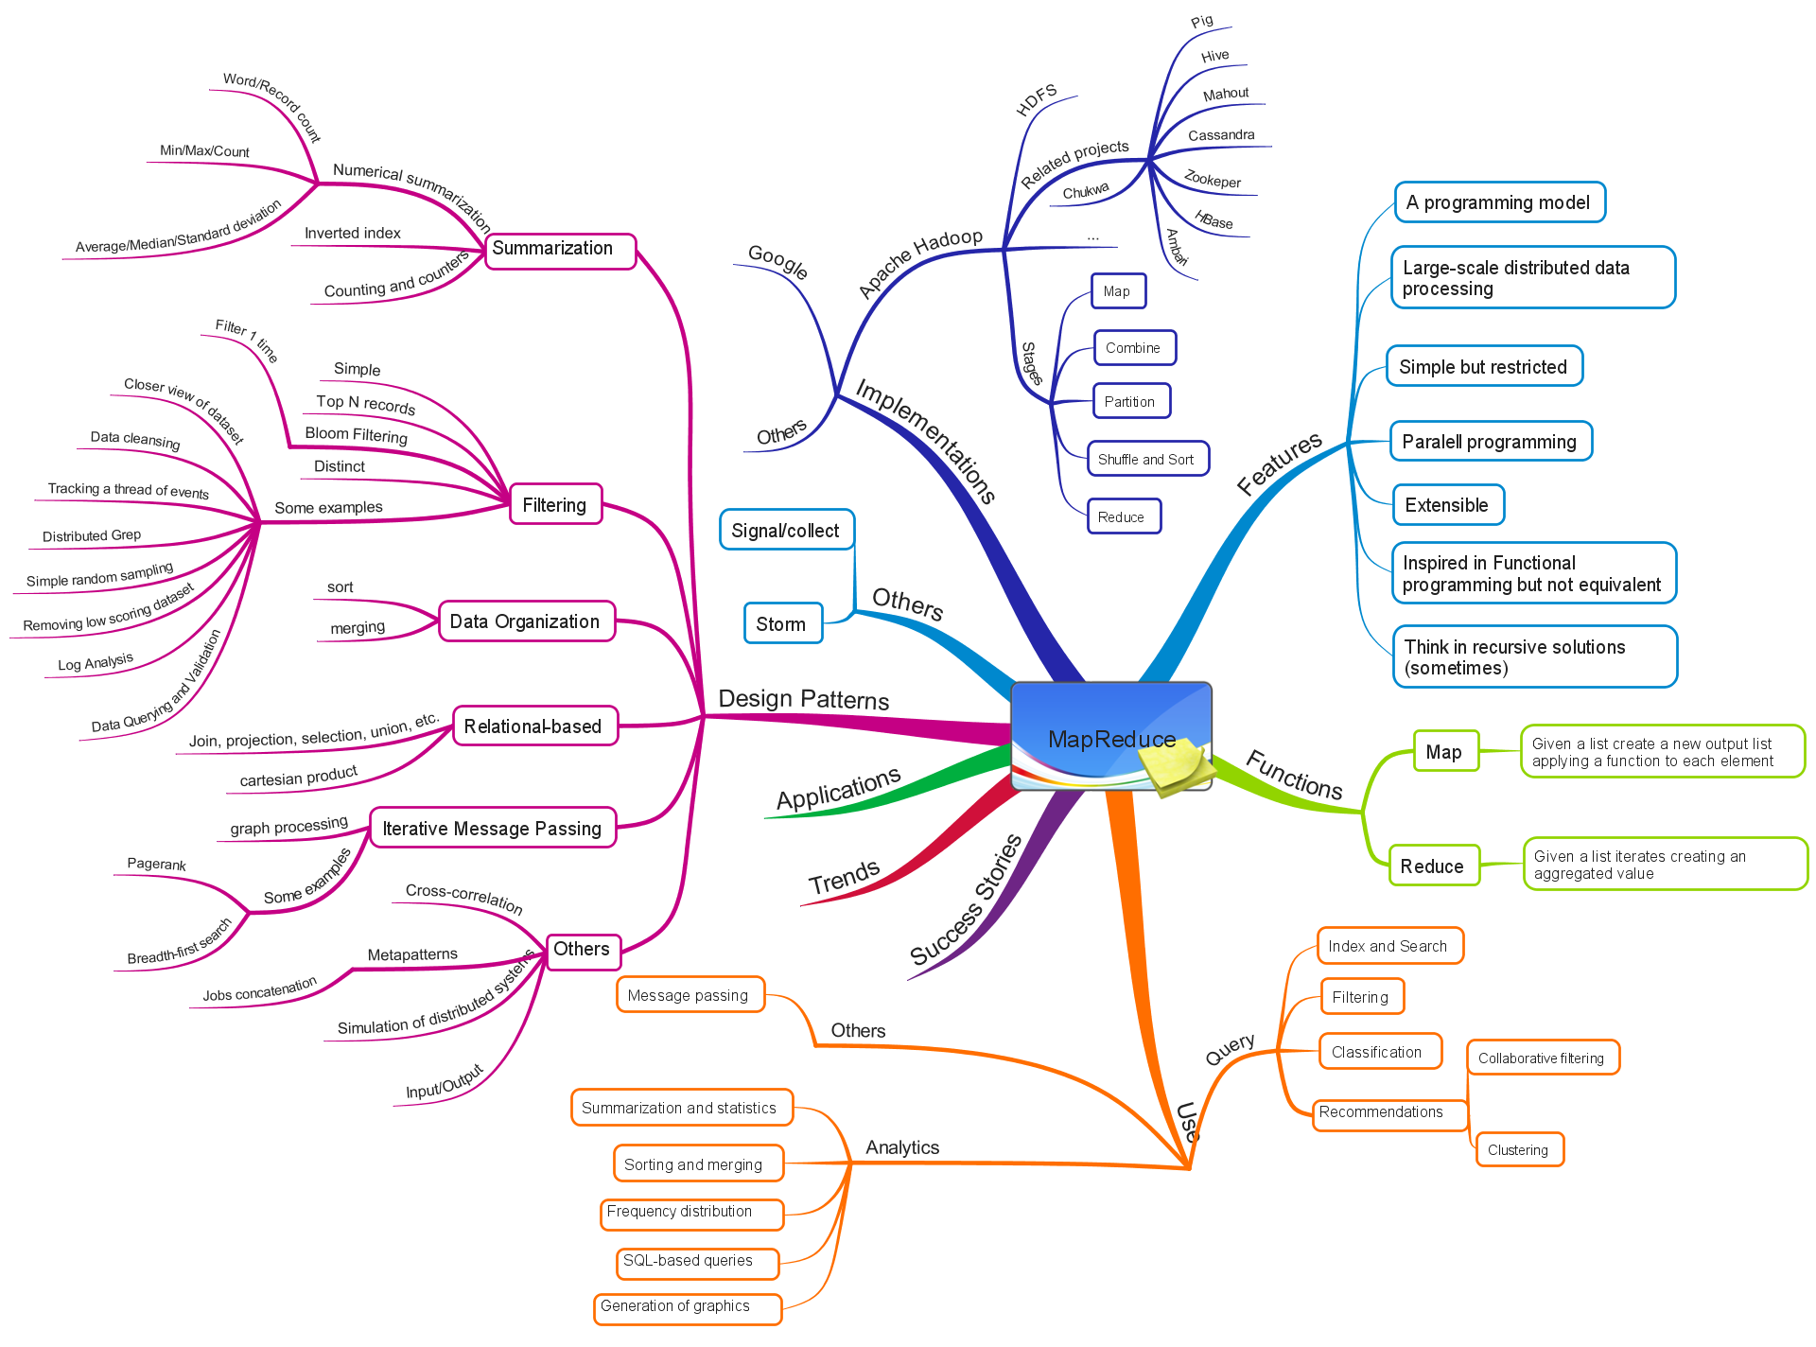
Course Contents

Slide 53
Big Data, Database, and Data Mining References
Big Data
Conferences: IEEE Big Data, The Strata + Hadoop World conferences
Database systems
Conferences: ACM-SIGMOD, VLDB, ACM-PODS, IEEE-ICDE, EDBT, ICDT, DASFAA
Journals: ACM-TODS, IEEE-TKDE, JIIS, J. ACM, etc.
Data mining and KDD
Conferences: ACM-SIGKDD, IEEE-ICDM, SIAM-DM, PKDD, PAKDD, etc.
Journal: ACM-KDD, Data Mining and Knowledge Discovery, KDD Explorations
AI & Machine Learning
Conferences: Machine learning (ICML), AAAI, IJCAI, COLT (Learning Theory), etc.
Journals: Machine Learning, Artificial Intelligence, etc.

Slide 54
Questions?

